Slide 1

Hierarchical Clustering and DBSCAN
Instructor
Abdullah Saihan
AI Engineer,

Slide 2
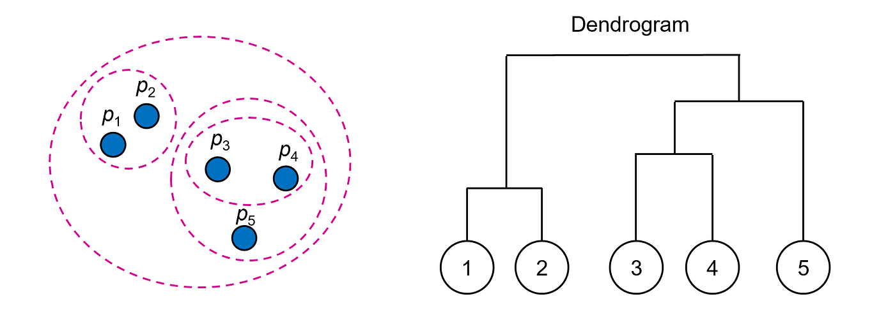
Hierarchical clustering is an unsupervised machine learning method that groups data points into a tree-like hierarchy of clusters based on their similarity

Slide 3
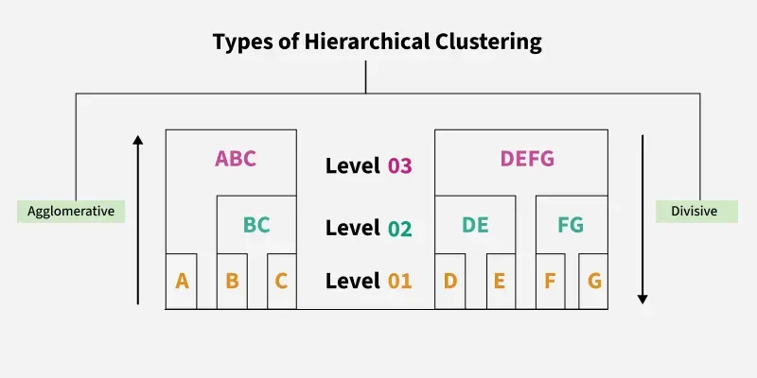

Slide 4
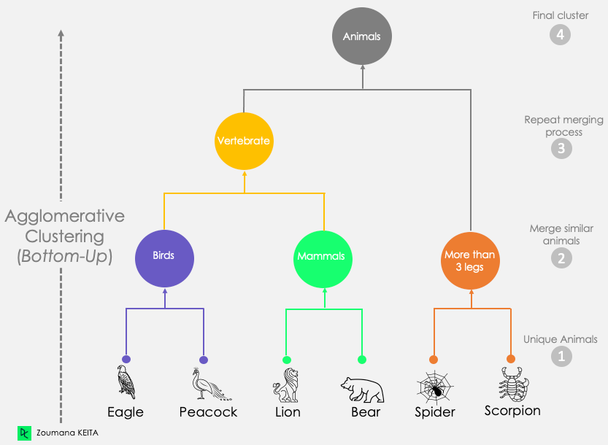

Slide 5
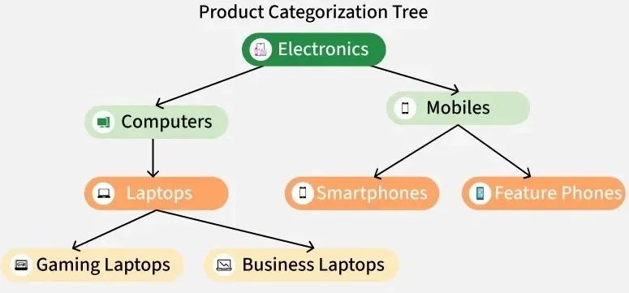

Slide 6
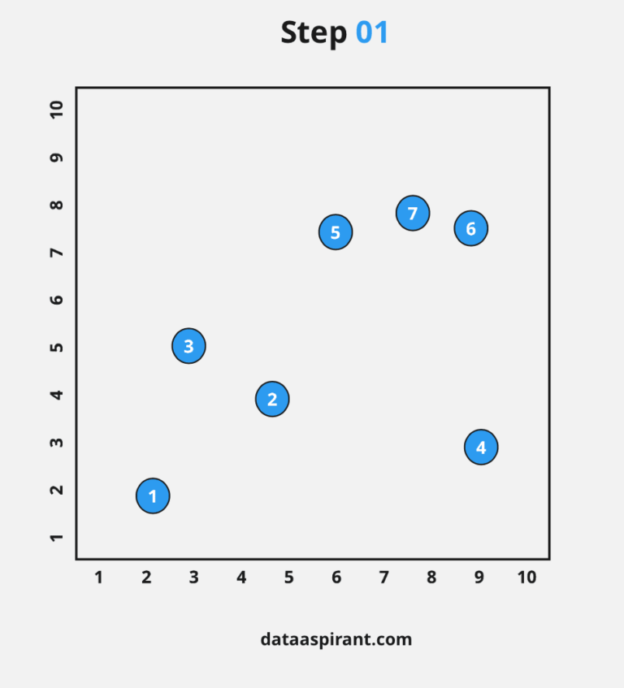
Step 1
First, make each data point a “single - cluster,” which forms N clusters. (let’s assume there are N numbers of clusters).

Slide 7
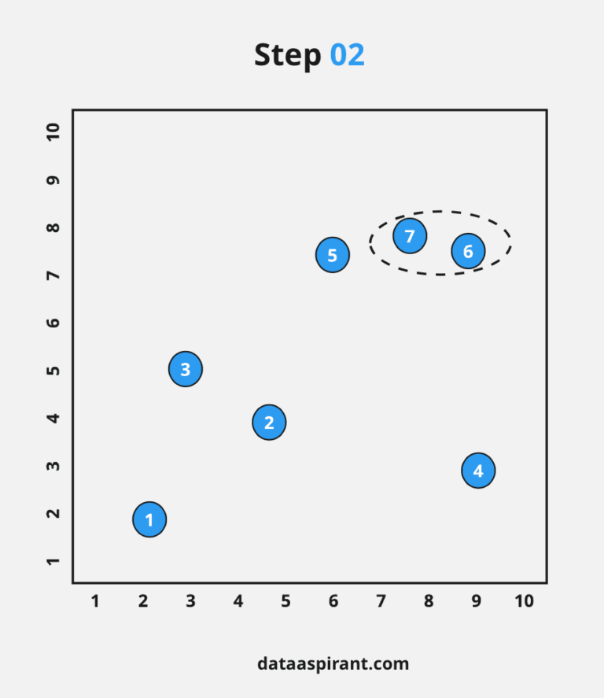
Step 2
Take the next two closest data points and make them one cluster; now, it forms N-1 clusters.

Slide 8
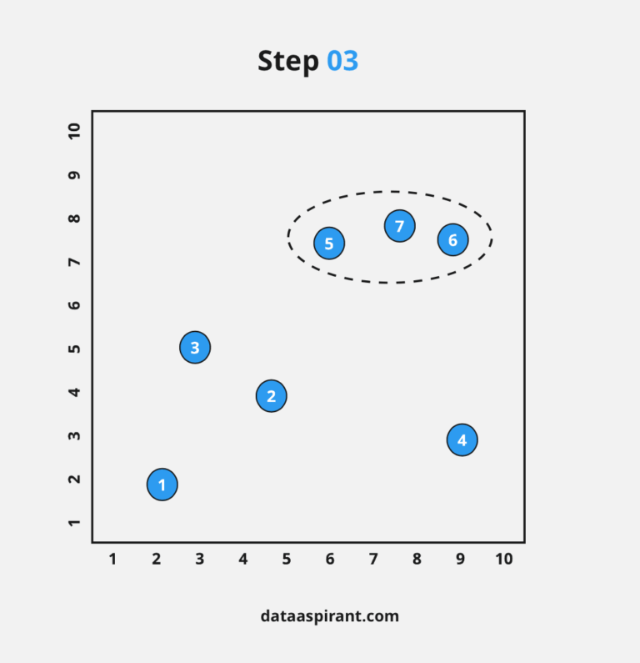
Step 3
Again, take the two clusters and make them one cluster; now, it forms N-2 clusters.

Slide 9
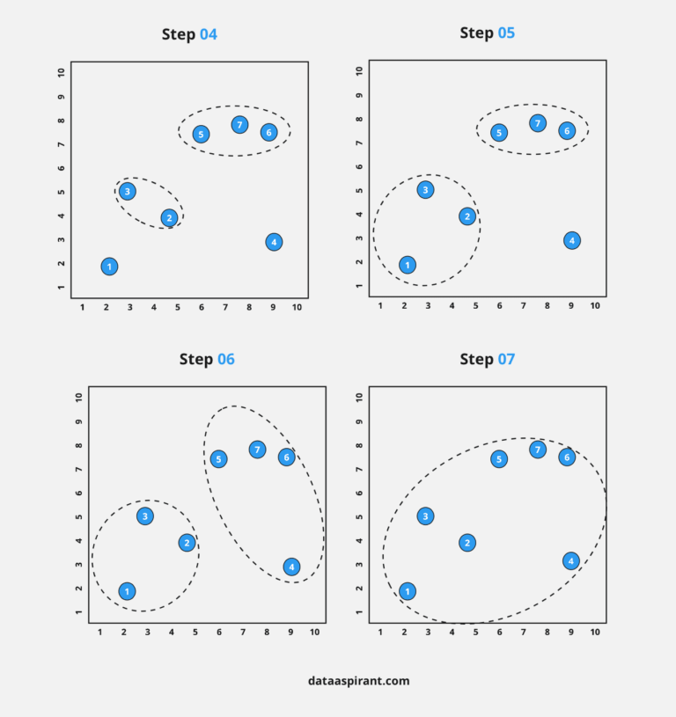
Step 4
Repeat ‘Step 3’ until you are left with only one cluster.

Slide 10
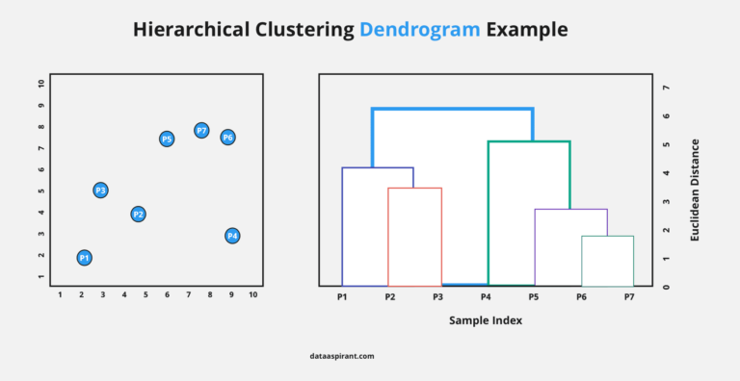
Once all the clusters are combined into a big cluster. We develop the Dendrogram to divide the clusters.

Slide 11
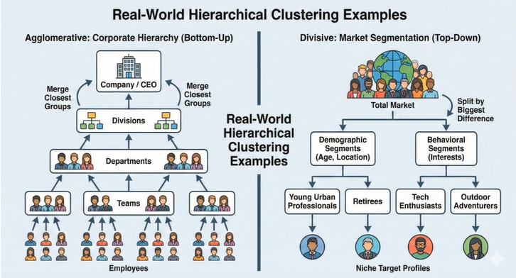

Slide 12
DBSCAN
In the DBSCAN (Density-Based Spatial Clustering of Applications with Noise) algorithm, data points are classified into specific categories based on how tightly packed they are with their neighbors.
To determine the classification of a point, DBSCAN relies on two key hyperparameters:
ɛ(Epsilon): The maximum radius of the neighborhood around a point.
MinPts: The minimum number of points required within the ɛ-neighborhood to form a dense region.

Slide 13
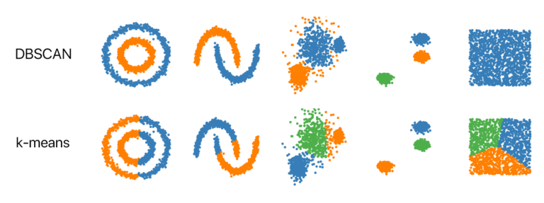

Slide 14
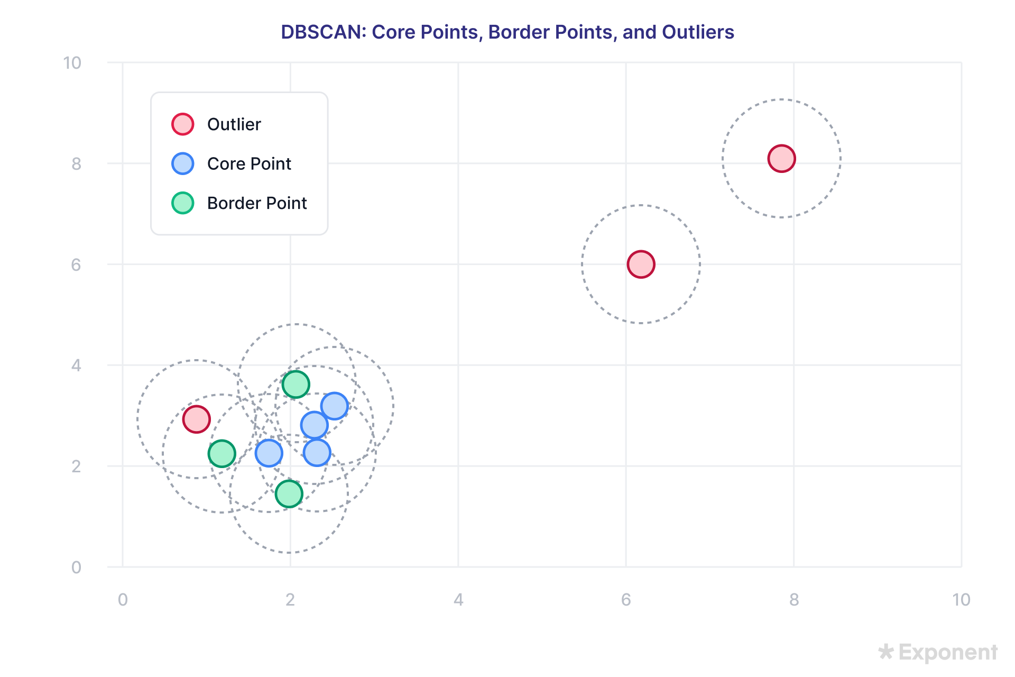
1. Core Point
2. Non-Core Points
Border / Adjacent Point
Outlier / Noise Point

Slide 15
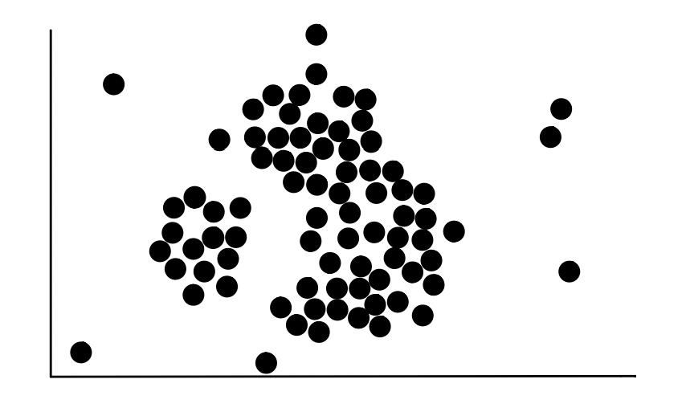
Raw Data
We start with a dataset containing unlabeled points.
No information about the number of clusters is required.

Slide 16
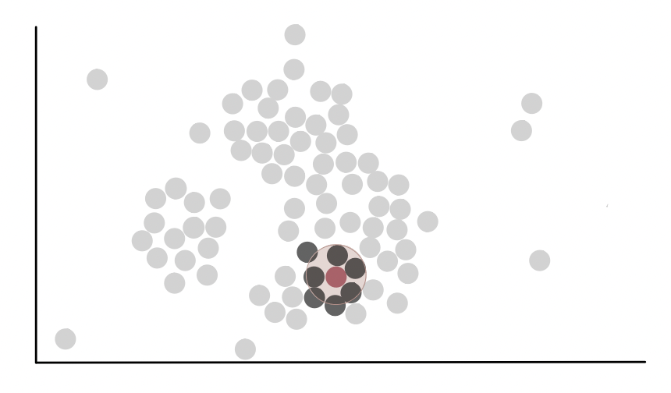
Let's pick a random point
Pick any point in the dataset.
Draw a circle around it.
The radius of the circle is ε (epsilon).
ε is a user-defined hyperparameter that determines the neighborhood size.

Slide 17
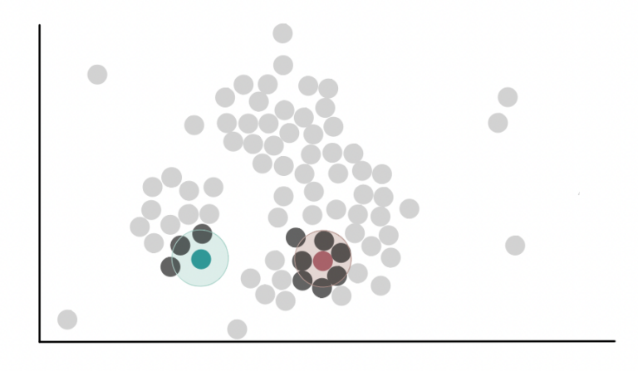
Neighborhood Points (Close Points)
Repeat these process for every point.
Draw an ε-neighborhood around each point.
Count how many points lie inside each neighborhood.
These are called the point's neighbors.

Slide 18
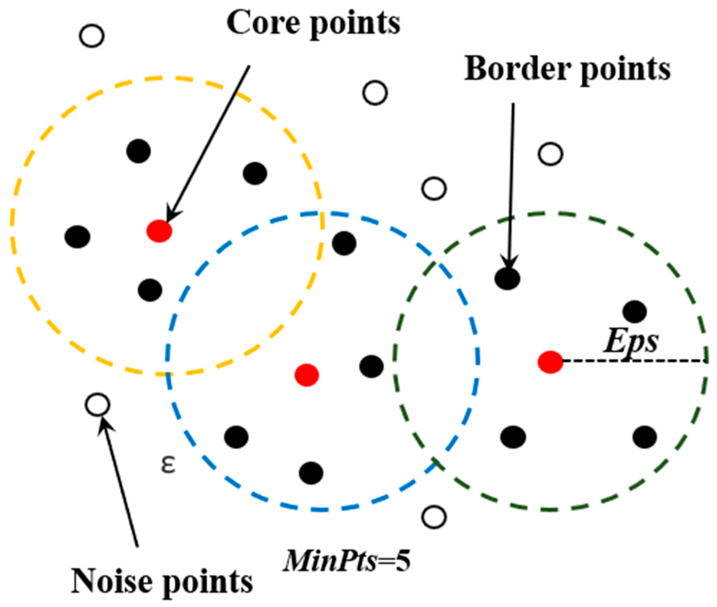
Core vs Non-Core Points
Choose another hyperparameter called MinPts.
For every point:
If the number of neighbors (including the point itself) is ≥ MinPts, it is a Core Point.
Otherwise, it is not a Core Point.

Slide 19
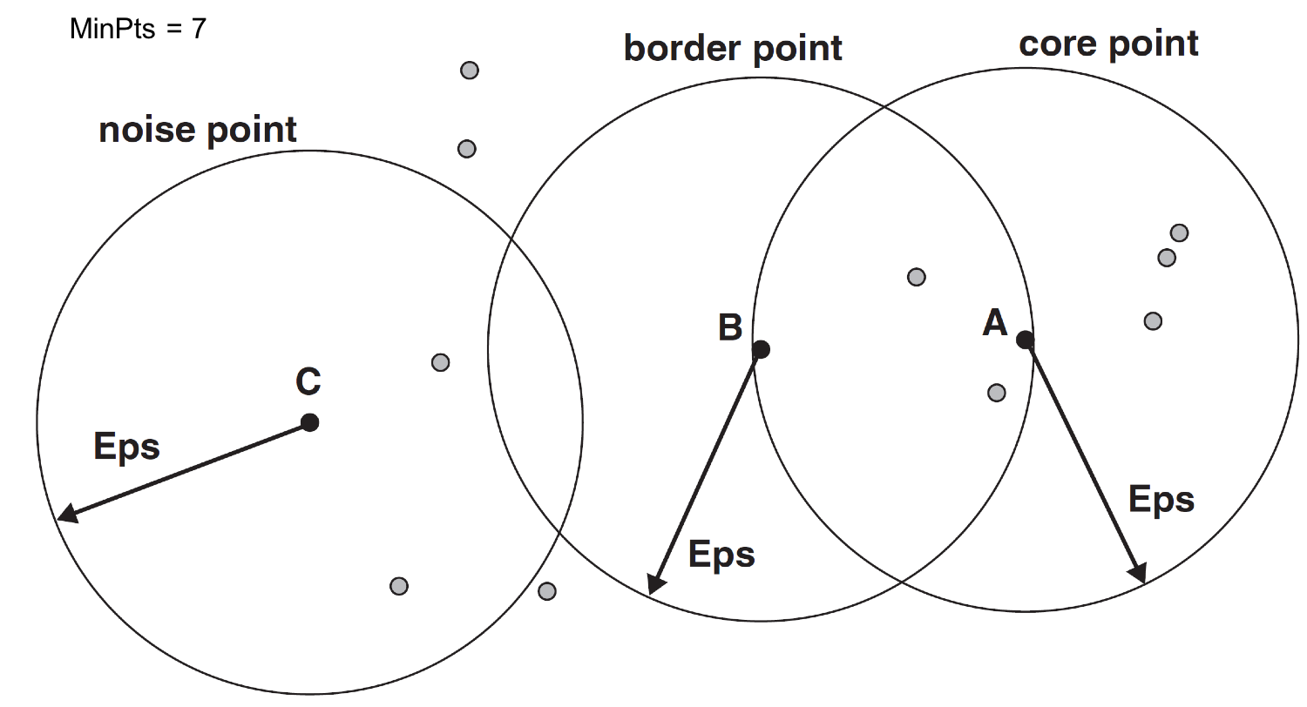
Border vs Noise Points
For every non-core point:
If it lies inside the ε-neighborhood of at least one Core Point, it is a Border Point.
Otherwise, it is considered Noise (Outlier).

Slide 20
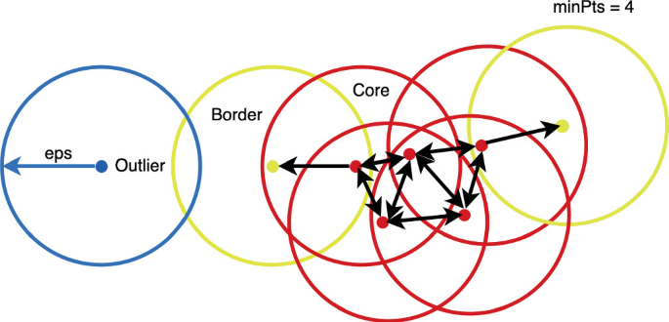

Slide 21
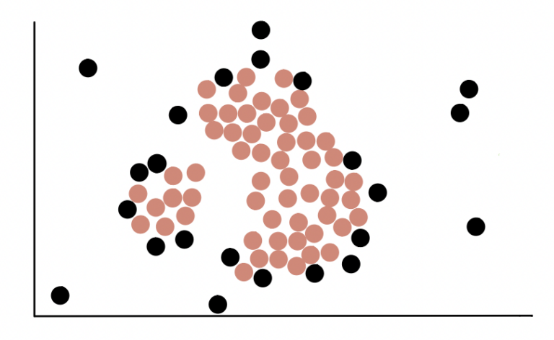
For each data point decide if it is a core point or non-core point.

Slide 22
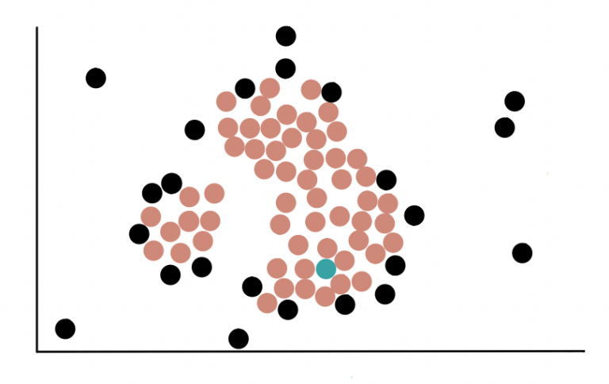
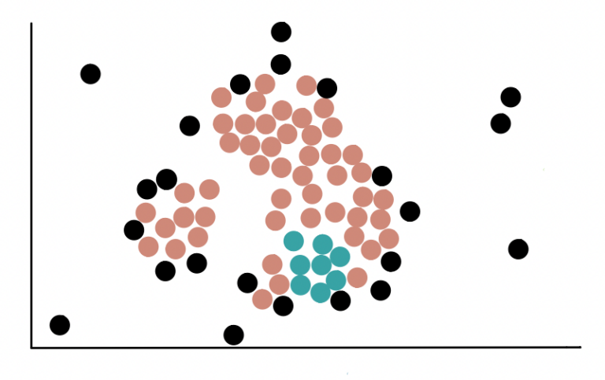
Form Clusters
Start from any Core Point.
Add all points within its ε-neighborhood.
If any of those points are also Core Points, expand from them as well

Slide 23
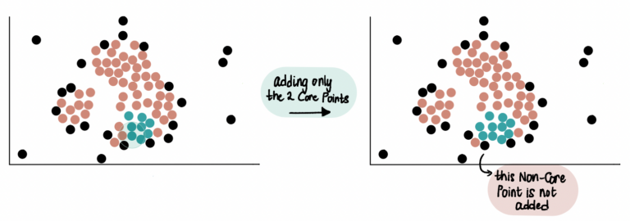
Form Clusters

Slide 24
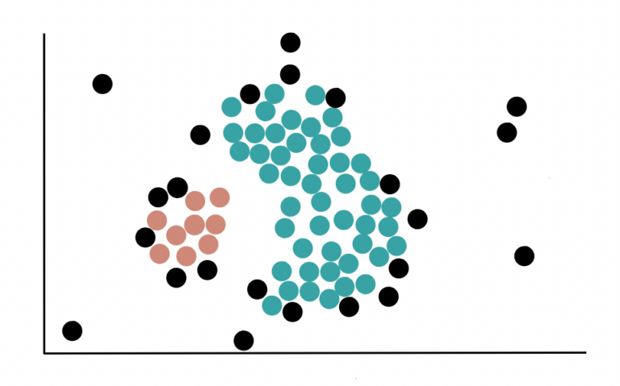
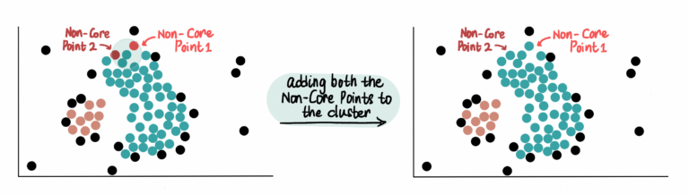
Form Clusters
Continue until no more reachable core points exist.
Unlike Core Points, Non-Core Points can only join a cluster and can not be used to extend it further .
This forms one cluster.

Slide 25
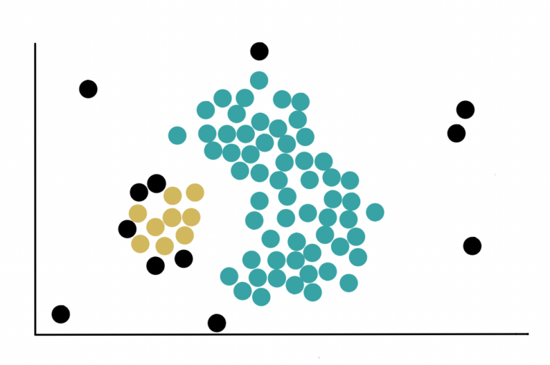
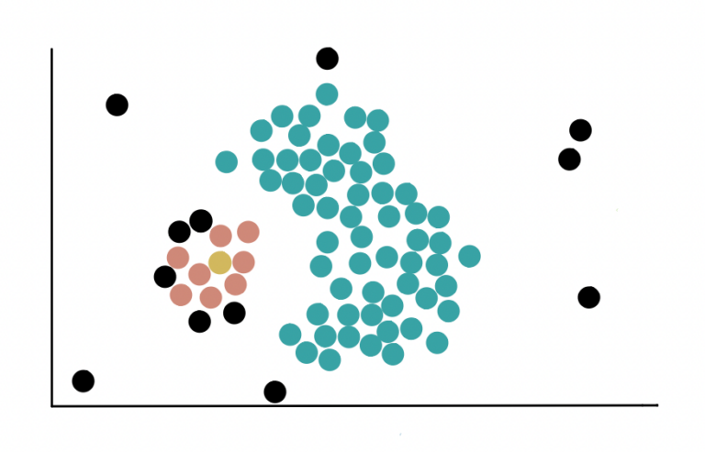
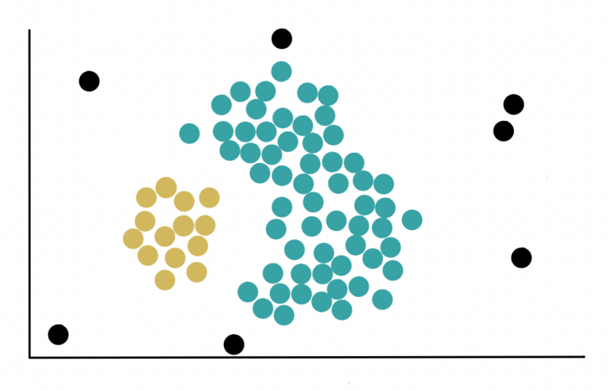
Form Clusters
Repeat the process with remaining unvisited core points.

Slide 26
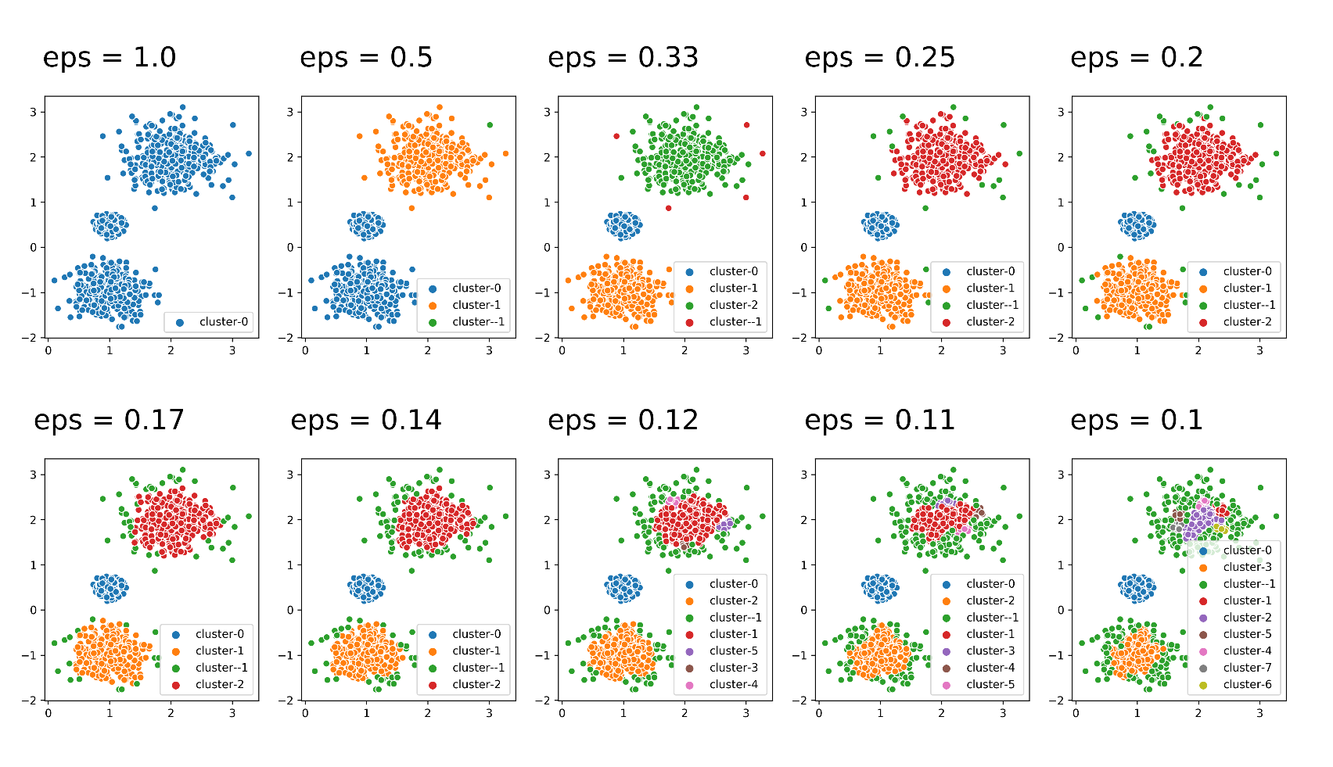
Effect of different radius (eps)

Slide 27
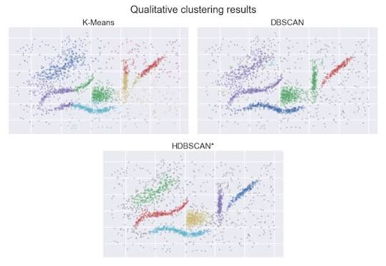

Slide 28
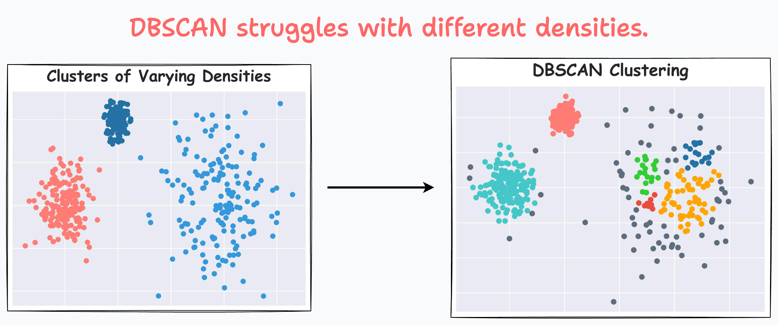

Slide 29
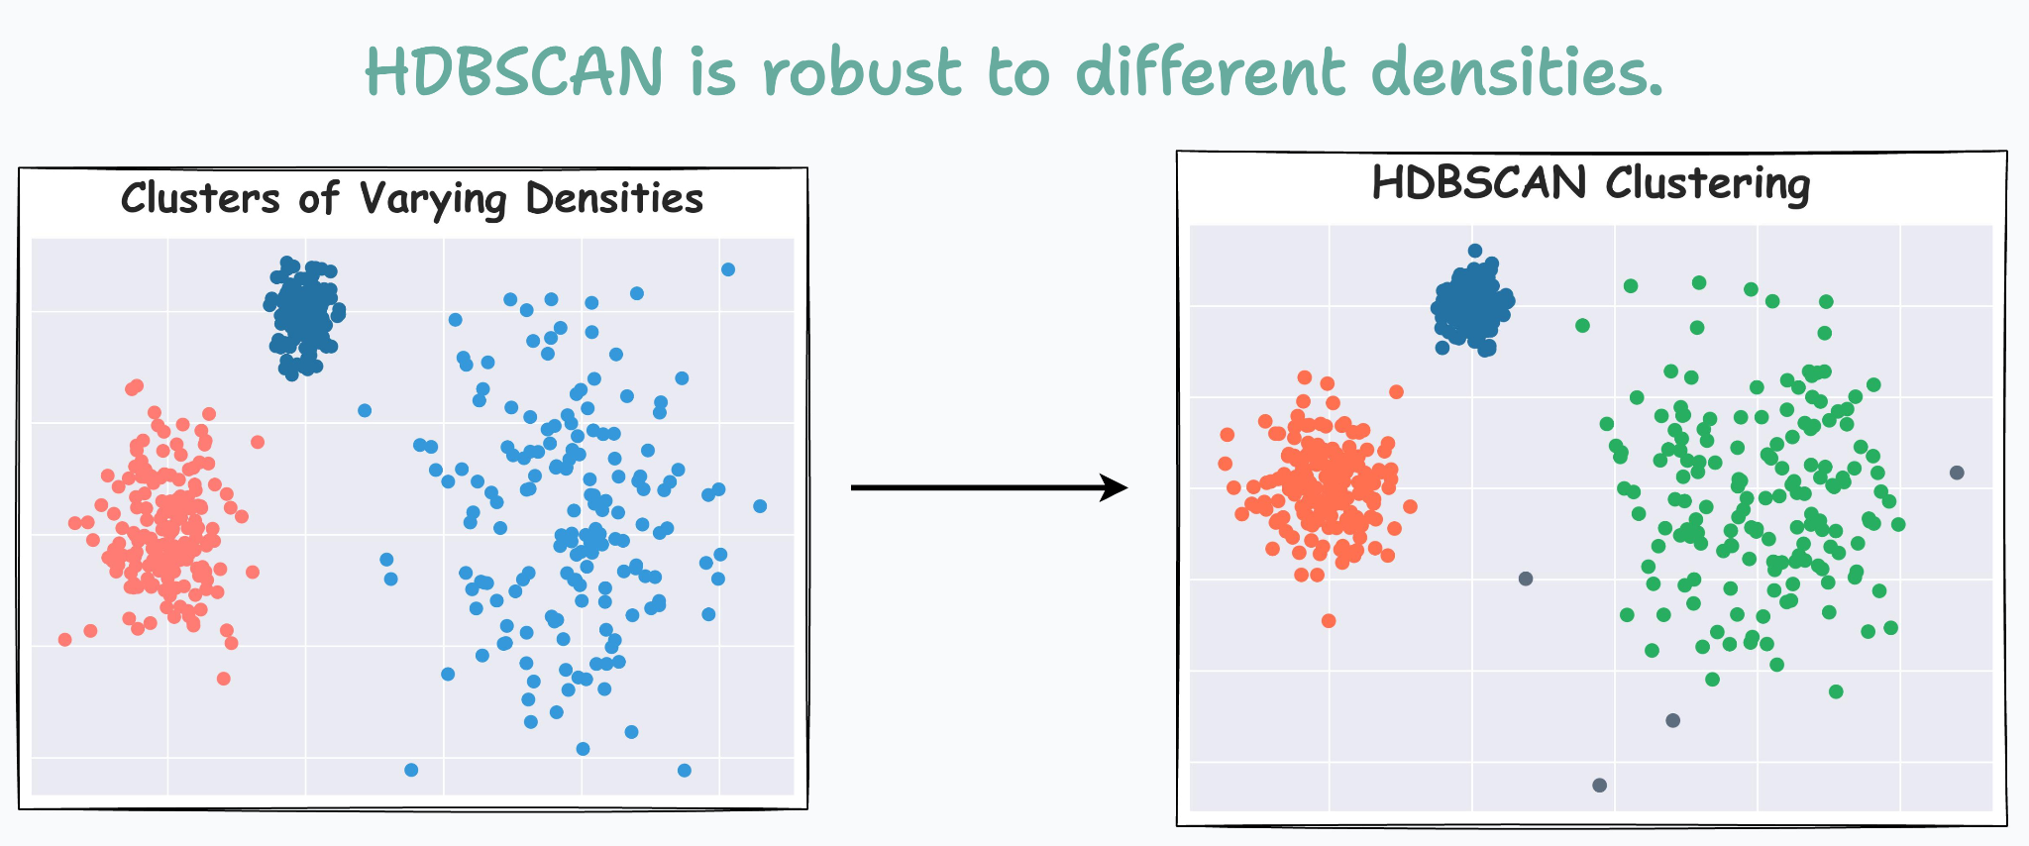

Slide 30
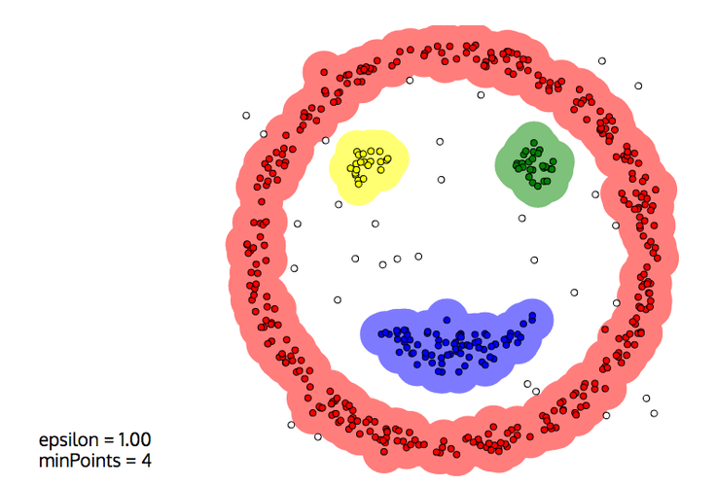
Example: Complex shape (Face)

Slide 31
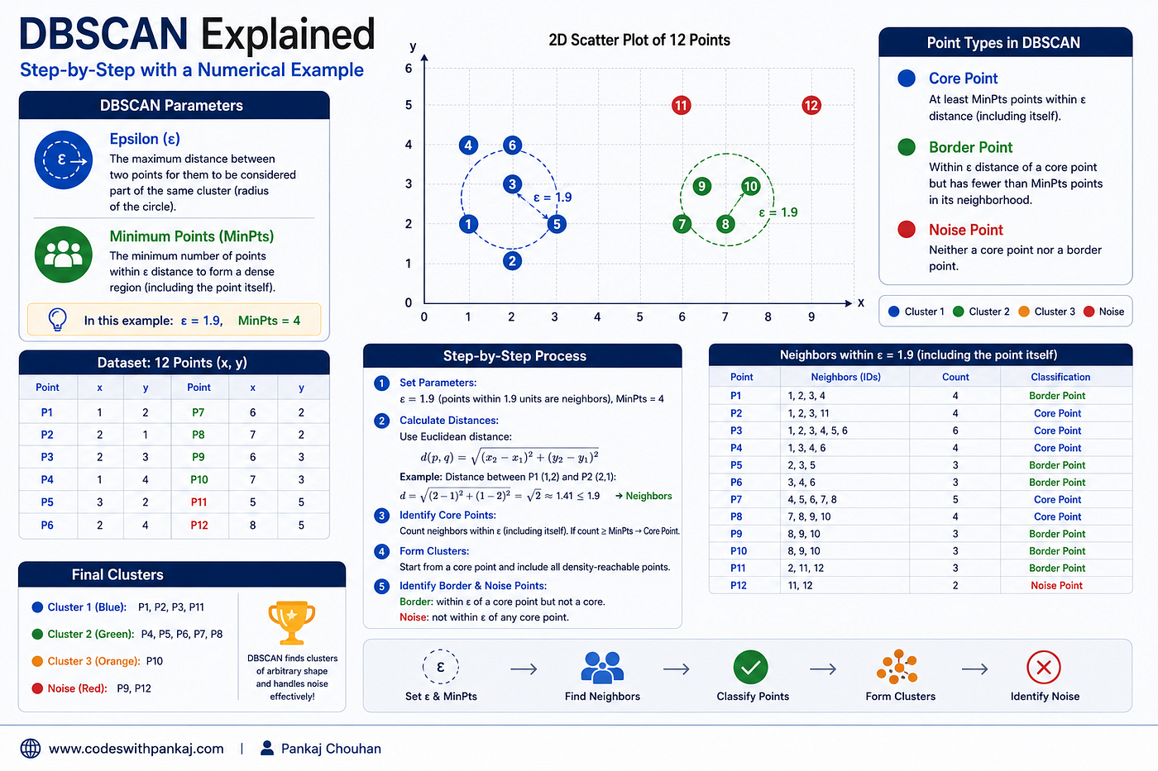

Slide 32
Thank You!

